Slide 1
TO DO
Would "Tab" or "Bill" be less confusing than "Order" since the term order can also mean the act of requesting an food-item and the food-item itself?
Full use cases in addition to use case table?
Glossary?

Slide 2
Group 3 Capstone Project Presentation 1
Fred Arandi
Charles Hafslund
Terry McCarthy
Othman Smihi
Mike Utenkov

Slide 3


Slide 4
Vision
A restaurant management application used to:
Enter, track, and delegate food and drink orders
Enter and track table statuses and reservations
Prioritize orders in the kitchen according to arrival of orders and required prep times
Handle billing
We envision this as a web application which may be adapted to Android if time allows.

Slide 5
Business Case
Restaurants are busy environments and inefficiencies can result in business failure even if the food is great.
Effective coordination of personnel and resources is key to timely service and customer satisfaction.

Slide 6
Business Case
Boost business by
Making waiting times smaller and more predictable
Maximizing customer throughput
Maximizing employee efficiency
Increasing customer satisfaction

Slide 7
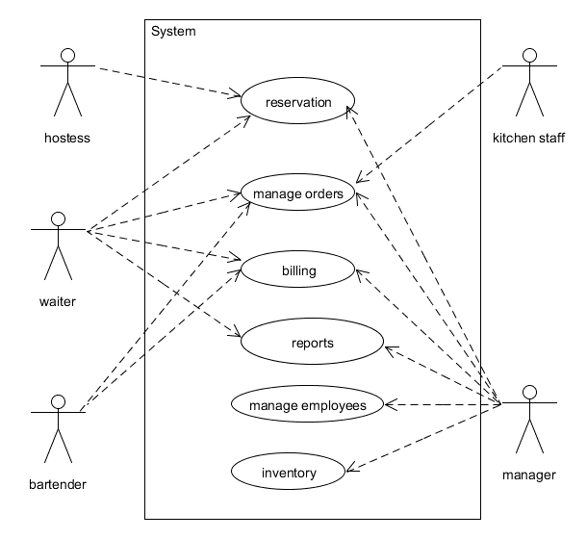
Actors
Waiter
Kitchen Staff
Hostess
Customer
Busboy
Bartender
Manager

Slide 8
Goals: Waiter
Enter customers' orders quickly and easily
Enter customers' orders without errors
Communicate customer orders to the kitchen
Access menu information on demand, as needed
Adjust bill splitting/sharing as needed
Mark what is from each person (seat number)
Take customer payment quickly and easily
See specials
Use coupons / codes
Receive tips
Take complaints

Slide 9
Goals: Kitchen Staff
View clear and accurate report of queued orders
View upcoming orders in terms of priority
Take ownership of orders
Mark items as completed

Slide 10
Goals: Customer
Have order recorded accurately
Receive an accurate bill,
including any splitting/sharing arrangements
Pay with a credit card easily and securely
Use coupons / codes
Make a reservation
Lodge a complaint

Slide 11
Goals: Manager
View aggregated information about sales
View aggregated information about inventory consumption
View aggregated information about employee work
Make adjustments to bill amounts
View complaints
Perform all other roles

Slide 12
Goals: Hostess
View which tables are open and which are not
View waiting times for tables
via check in and check out, average duration
View which tables may be open soon
See table capacities
View table server assignments
by zone

Slide 13
Goals: Busboy
Indicate that tables are ready for seating, easily and without error
See which tables need to be cleaned (indicated by bill paid)

Slide 14
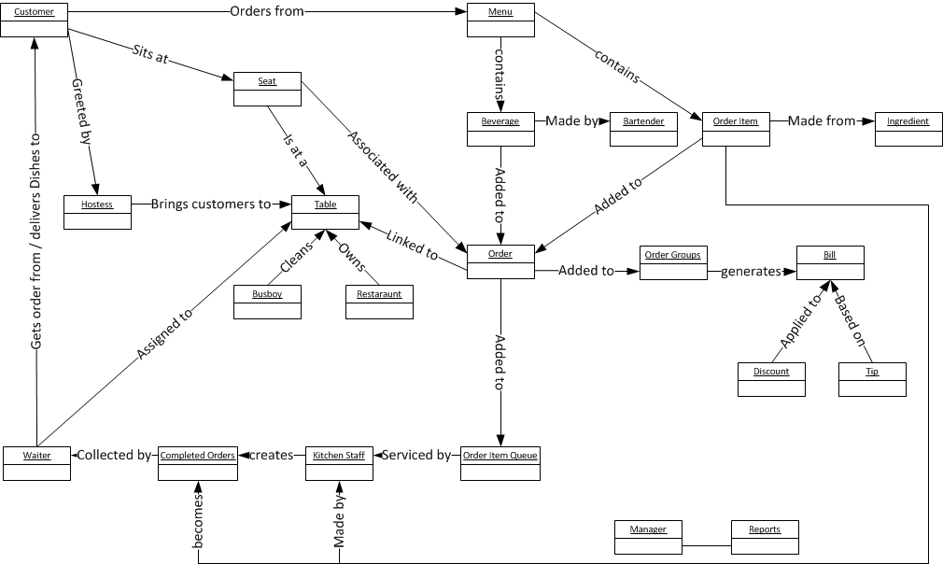
Domain Model

Slide 15
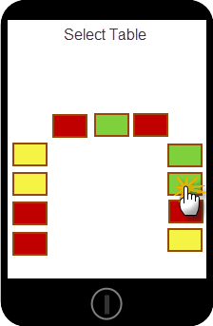
Basic Idea- Table Mgmt
Hostess, Waiters, and Bus Boys interact with a listing of tables.
Each role interacts with tables differently.

Slide 16
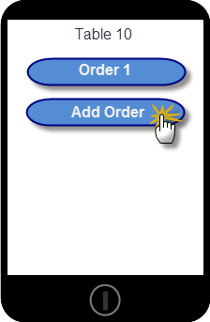
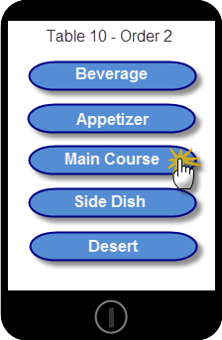
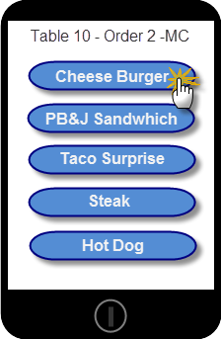
Basic Idea – Taking Orders
Waiters will be able to quickly add an order to a table using a categorized menu system.

Slide 17
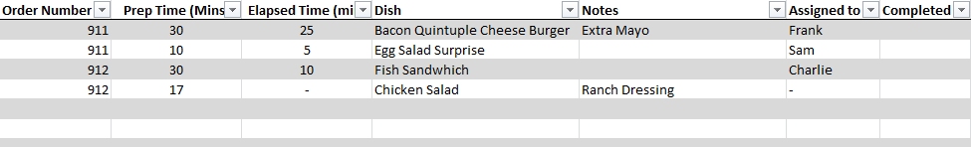
Basic Idea – Kitchen Staff
Kitchen Staff use a touch display that sorts order items in the following manner:
Table Orders queued in FIFO
Order Items queued within Table Group by longest prep-time first (LPTF) to synchronize their completion

Slide 18
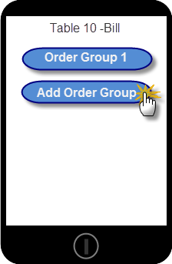
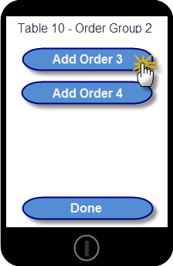
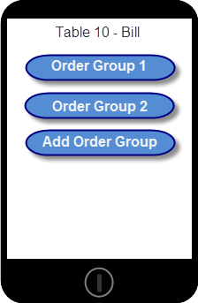
Basic Idea – Billing
Waiters will be able to quickly group orders into Order Groups for split billing.

Slide 19
Main Success Scenario
Customer enters
Hostess checks for available tables / estimated wait-time
Customer seated by hostess, table marked occupied and assigned to a waiter
Drinks, Appetizers, meals: ordered /prepared / delivered

Slide 20
Main Success Scenario
Ordering: order-items (drinks and dishes) are added to order-group which is placed in an order-queue by wait-staff
Preparation: order-group is removed from the order-queue by kitchen staff, order-items are prepared (in LPTF order), and the order-group is placed in the delivery-queue. Inventory is updated.
Delivery: item is delivered and removed from delivery-queue by wait-staff.

Slide 21
Main Success Scenario
Queue order is processed by an algorithm that:
Order-groups queued in FIFO
Order-items queued within order-group by longest prep-time first (LPTF) to synchronize their completion

Slide 22
Main Success Scenario
People enjoy food and drinks and possibly order more things.
Meal completed.
Bill is totaled and presented.
Bill and tip can be paid electronically
Bill is designated “settled”

Slide 23
Main Success Scenario
People leave.
Table placed in bus queue
Table is cleaned, removed from bus queue, and marked as available

Slide 24
Preliminary Use Cases
ID | Name | Scope | Primary Actor | Compelxity | Priority
1 | Menu view | In | Anyone | Low | 1
2 | Place Order | In | Customer | Low | 1
3 | Deliver Order | In | Waiter | Low | 1
4 | Order review | In | Waiter/customer | Low | 1
5 | Manage Table | In | Waiter | High | 2
6 | Order check off | In | Kitchen staff | Med | 1
7 | Reservation | In | Customer | Med | 2
8 | Item's metadata | In | Anyone | Med | 2
9 | Inventory | In | Manager | Low | 1
10 | Complaint | In | Manager/waiter | Med | 2

Slide 25
Risks
Fast application speed: Do not try customers’ patience.
High reliability: Downtime must be avoided
Credit card PCI information handling
Billing accuracy
Logins securely connect users with their correct role
Effective prioritization algorithm for orders and dishes

Slide 26
In Scope
Queue customers waiting to be seated
Table management:
Table capacity
Server assignments
Ready to clean / cleaned status
Menu
Send orders to kitchen
Payment API (stub)
Employee names and roles
Consumption report of ingredients
Sales numbers
Mobile site
Bill splitting
Tips
Prioritize orders in the kitchen
Customer time in/out
Busboy role
Drinks as items
Dish categories (app, main, dessert, drink, etc.)
Basic account authorization & security
Kitchen UI (queue display)

Slide 27
Out of Scope
Specifics of payment
PCI compliance
Payroll, time clocks
Inventory management
Complaints
Bar management
Splitting bill for a single item
Custom table setups
Recipes
Customer directly using the application

Slide 28
Scope Undecided
Reservations
Basic employee stats
Mobile app
Discounts / adjustments (comping)
Parties spanning > 1 table

Slide 29
Planning: Time
12 weeks
5 people
9 hours / person•week
540 hours total

Slide 30
Planning: Estimated Man-hours
App Design | 140
Mobile App | 120
Web app | 120
Server code | 60
Testing | 50
Database | 25
Graphics/Design | 25

Slide 31
Glossary of Terms
Table: A set of customers sitting together and ordering for the same meal.
Seat: A single person at a table, identified by number.
Item: A dish or drink on the menu that a customer can order.
Item Type: An attribute of an item. Values include, Appetizer, Main, Dessert, Drink, etc.
Order: A set of items ordered by a customer at a seat.
Order Group: Orders to be paid by the same payee.
Bill: All Items belonging to a table, includes the price of each Item and the total price.
Order Item Queue: List of Orders, used in the kitchen to plan for orders to be prepared on a first-come first-served basis (grouped by Table).
Item Queue: List of Items, used in the kitchen to plan for Items of the same Type to be ready for each seat at a table at the same time.
Service Queue: Collection of Items of the same type ready to be delivered to a table.
Bus queue: List of tables ready to be cleaned and prepared for new customers.
Table status: Attribute of Tables determining next action that can be taken. Values include: occupied, bus-queue, available.

